Slide 1
Term Project Proposal:
Children Books
Gen AI
Philipp PETER - 49004549
Maja Sofie KIRSCHNICK - 49004549
You Jin KIM - 49004572
Agustina ROMERO RODAS - 49004595

Slide 2
Table of Contents
01
02
03
04
05
06
07
08
Introduction
Requirements
Related Work
Architecture
Task
Decomposition
Story
Decision Tree
Software
Schedule

Slide 3
Introduction
Problem Description
Traditional children's books often lack interactivity
Competition with multimedia experiences
Static narratives may not engage young readers
Solution Description
Interactive Elements: Sound effects for immersive experience, Reader choices impact the story
QR Code Integration: Access images for depth
User-Friendly Interface: Animated page transitions for engagement
Multiple Endings: Happy and child-friendly sad endings, explanations for understanding choices

Slide 4
Final Product
A Python program capable of generating a simple, animated children's book with interactive features.
AI-generated code fragments to support the interactive elements and functionality of the book.
AI-generated images, sounds, and videos to enhance the visual and auditory aspects of the book.
An AI-generated story that forms the core narrative of the book.
Comprehensive documentation that outlines the technical aspects, usage, and generation process of the book.

Slide 5
Requirements
Functional
Non-functional
Interactivity
QR Code Integration
User Interface (UI)
Multiple Endings
Compatibility
Reliability
Scalability
Usability
Accessibility
Data Privacy
Testing and Quality Assurance
Legal and Copyright Compliance

Slide 6
Related Work
Series
Video Games
Books
Netflix for example offers movies and series where the storyline can be controlled by the user. [1]
In "Until Dawn", players can directly influence the story by making choices and interacting with the game's characters and world. [2]
In "Choose Your Own Adventure" books like "The Cave of Time", readers skip to different chapters based on their choices. [3]

Slide 7
Architecture
Start
Story
Generation
Backend
Development
Media Content
Generation
Frontend
Design
Testing
End
Deployment

Slide 8
Software Requirements
01
02
03
04
Story Generation
Media Content Generation
Frontend Design
Backend Development
Using LLMs (ChatGPT, Bard) to generate the book's story.
Utilizing AI tools such as DALL·E to generate images and media.
Using Pygame for UI design and animating book pages.
Python backend for logic and AI content integration.

Slide 9
Task Decomposition
Storyteller
Media Creator
Programmer
Develop a child-appropriate storyline with decision points.
Generate story-aligned visual assets and design.
Develop a Python backend integrating the story and visual assets.
Maja Sofie KIRSCHNICK
You Jin KIM
You Jin KIM
Agustina ROMERO RODAS
Philipp PETER
Agustina ROMERO RODAS

Slide 10
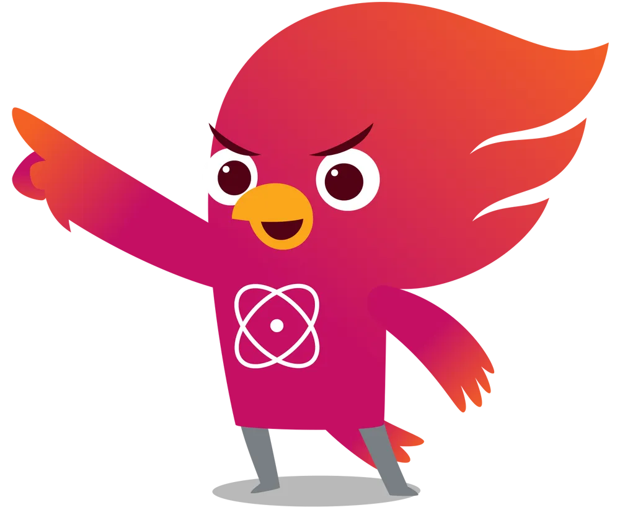

Story Decision Tree
Love or War Story?
Ten outcomes
Five choices
Choices on each page
Two Kingdoms and their histories
Ten outcomes
Five choices
One choice on each page
History of two kingdoms
…
Bad Ending
Happy Ending
…
…
Notes:
Responsible for creating the storyline, defining the possible decision points in the narrative, considering various endings, and ensuring that the story conveys meaningful lessons for children.

Slide 11

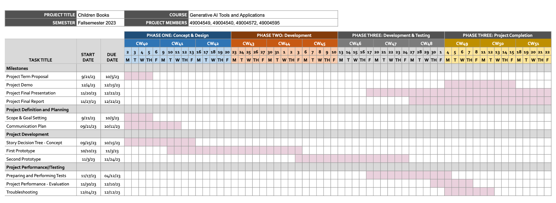
Project schedule: Gantt chart

Slide 12
Resources
[1] D. Espla, "Interactive series and movies on Netflix: what it means and titles," El Output. [Online]. Available: https://eloutput.com/en/movie-series/lists/netflix-interactive-content/. [Accessed: Oct. 5, 2023].
[2] A. Chatziioannou, "Is the interactive horror movie making its long-overdue comeback?," Washington Post, Nov. 2022. [Online]. Available: https://www.washingtonpost.com/video-games/2022/11/07/interactive-horror-movie-the-quarry-until-dawn/. [Accessed: Oct. 5, 2023]. ISSN: 0190-8286.
[3] G. Hendrix, "Choose Your Own Adventure," in Culturebox, Slate, Feb. 2011. [Online]. Available: https://slate.com/culture/2011/02/choose-your-own-adventure-books-how-the-cave-of-time-taught-us-to-love-interactive-entertainment.html. [Accessed: Oct. 5, 2023]. ISSN: 1091-2339.

